Slide 1
Using Data to Drive Results
Cyndi Fowler
Executive Coach Director

Slide 2
Learning Objectives:
Effectively use data to drive results.
Evaluate data trendlines as they relate to action planning.
Connect the dots between data analysis, validation, and leadership accountability.
© 2022 Huron Consulting Group Inc. and affiliates.
Notes:
You may have heard the saying, “In God we trust, all others bring data…”
It speaks to the notion that we can often form opinions and even conclusions that are not correct, based on limited evidence.
July 23rd, 1983 Air Canada flight 143 took off from Montreal headed to Edmonton….with half the fuel it needed for the journey. The airline industry is one of the richest in data and analytics and it has a strong safety record with redundancies at every turn. How did this happen? Was data to blame?

Slide 3
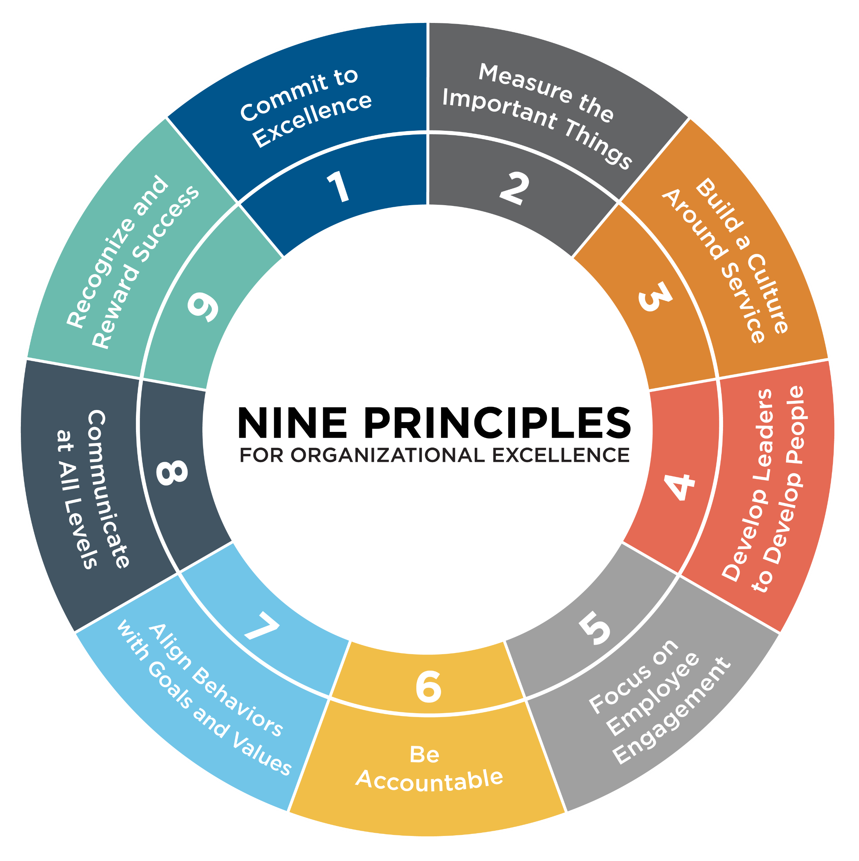
Nine Principles® Framework
Principle 1: Commit to Excellence
Set high expectations to achieve results while living out mission and values.
Principle 2: Measure the Important Things
Continuously track progress to achieve results with an improvement mindset.
Principle 3: Build a Culture Around Service
Serve others with great care and concern.
Principle 4: Develop Leaders to Develop People
Coach people to be their best at work.
NINE PRINCIPLES®
Principle 5: Focus on Employee Engagement
Attend to aspirations and desires in the workplace.
Principle 6: Be Accountable
Commit to individual accountability to achieve organizational goals.
Principle 7: Align Behaviors with Goals and Values
Apply consistent practices to move the organization in a positive direction.
Principle 8: Communicate at All Levels
People know why what they do matters.
Principle 9: Recognize and Reward Success
Value and appreciate people working together to get results.
 | Principle 2: Measure the Important Things | Principle 8: Communicate at All Levels
Principle 4: Develop Leaders to Develop People
© 2022 Huron Consulting Group Inc. and affiliates.

Slide 4
Effectively Using Data:
Principle 2
© 2022 Huron Consulting Group Inc. and affiliates.
Notes:
July 23rd, 1983 Air Canada flight 143 took off from Montreal headed to Edmonton….with half the fuel it needed for the journey. The airline industry is one of the richest in data and analytics and it has a strong safety record with redundancies at every turn. How did this happen? Was data to blame?

Slide 5
Moving the Needle: Using Data to Drive Results
© 2022 Huron Consulting Group Inc. and affiliates.

Slide 6
What Kinds of Data are you Tracking Now?
Sli.do Link: www.sli.do
Code: 1181173
© 2022 Huron Consulting Group Inc. and affiliates.
Notes:
Add slido question here with word cloud

Slide 7
Join at slido.com #1181173
ⓘ Start presenting to display the joining instructions on this slide.

Slide 8
What kinds of data are you tracking now?
ⓘ Start presenting to display the poll results on this slide.

Slide 9
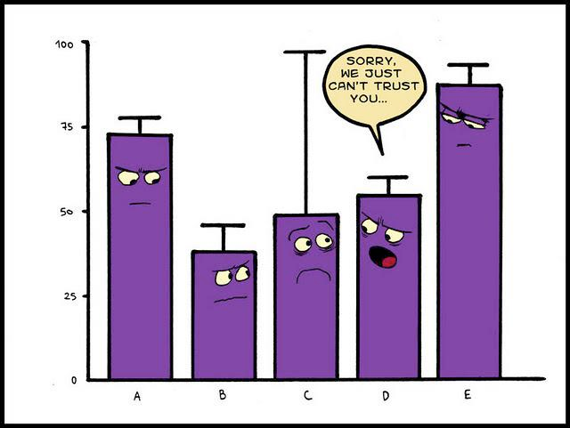
YES, I AM A DATA NERD!
© 2022 Huron Consulting Group Inc. and affiliates.
Notes:
Data tells a story but do we always take the time to evaluate the story? Often we jump to conclusions based on assumptions or antedotal information. We need more staff at 7a to get our patients registered….

Slide 10
What is the #1 job
organizations need
from all leaders?
© 2022 Huron Consulting Group Inc. and affiliates.

Slide 11
To MOVE Organizational RESULTS!
It requires:
Skill
Will
Tools and processes to facilitate focus and consistent execution
Data- quantitative (the numbers) and qualitative (subjective analysis)
Effective and efficient methods of communication, oversight, and follow-up (Validation)
© 2022 Huron Consulting Group Inc. and affiliates.
Notes:
Step back and ask ourselves, what is….

Slide 12
Making the Right Diagnosis to Drive Results
© 2022 Huron Consulting Group Inc. and affiliates.
Notes:
We need more staff at 7a to get our patients registered….

Slide 13
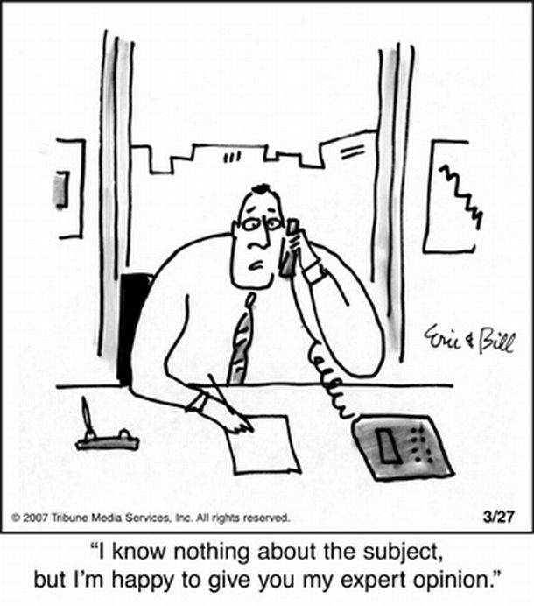
Data analysis and management is critical to making a sound diagnosis
Measure the important things
Track and trend your results (look back –project ahead for action plans)
Include both qualitative (observation) and quantitative (the numbers) data
Remember- one data source only gives you one part of the story
Stop “arm-chair” leadership
© 2022 Huron Consulting Group Inc. and affiliates.
Notes:
You need three data points to establish a trend line

Slide 14
Qualitative Data
Focus Groups
Rounding
Team Meetings
Monthly Supervisory Meeting
Walk Arounds/Observations
First Impressions Audits
© 2022 Huron Consulting Group Inc. and affiliates.
Notes:
Observation, walking the gimba, asking the right questions

Slide 15
Quantitative data: What do these numbers mean?
© 2022 Huron Consulting Group Inc. and affiliates.
Notes:
Hmm, back to air Canada – do we think they had qualitative data?

Slide 16
Data and root cause analysis:
Where assumptions live
Where solutions are found
© 2022 Huron Consulting Group Inc. and affiliates.

Slide 17
The Pitfalls
Organizations that lack a strong culture of data-driven decision making can get caught up in some variation of “the loudest voice wins.” Without an objective means of data-supported decision making, managers with the most persuasive or aggressive personal styles often win – whether or not their pet projects are the most beneficial to achieving targeted goals.
© 2022 Huron Consulting Group Inc. and affiliates.
Notes:
Watch out for those folks who may have the loudest voice at the table – either literally or because of a power situation. Consider how

Slide 18
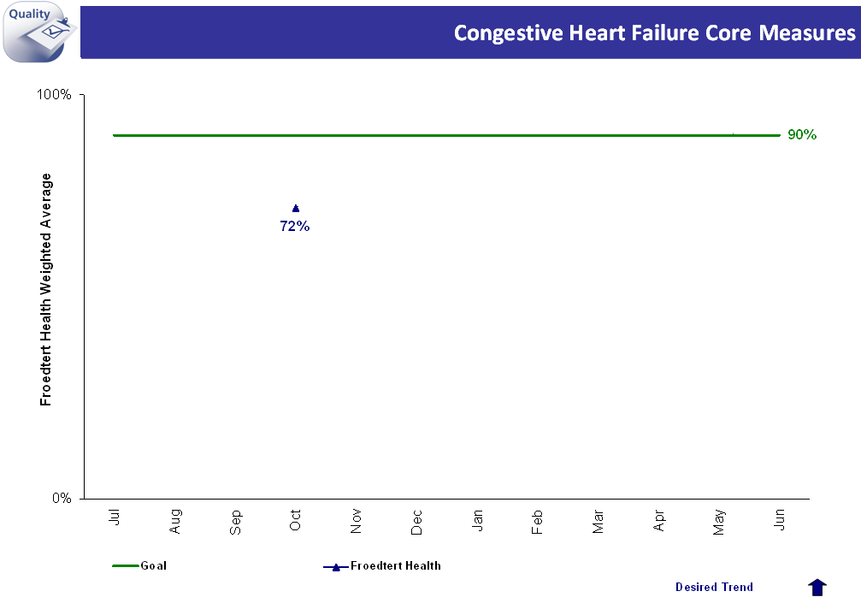
Data Trending: Will One Month Of Data Tell You The Whole Story?
© 2022 Huron Consulting Group Inc. and affiliates.

Slide 19
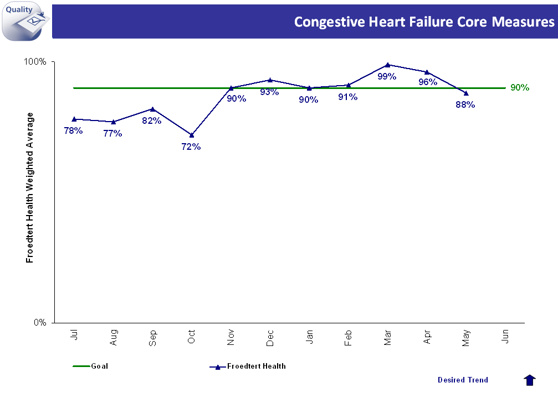
Data Trending: Looking at Data With A Long View Is a Better Diagnostic Tool
© 2022 Huron Consulting Group Inc. and affiliates.

Slide 20
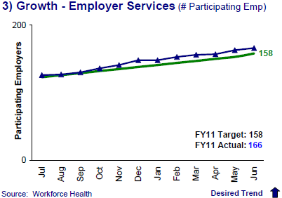
Trend Lines Help To Diagnose The Opportunity and Establish Appropriate Treatment Plans
Action Plan: Stay the course- current action plans are working! Reward and Recognize. Use accelerators (new tools and tactics) to advance success.
© 2022 Huron Consulting Group Inc. and affiliates.

Slide 21
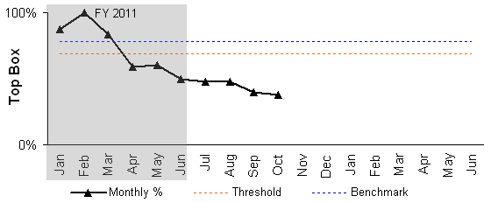
Trend Lines:
NEW ACTION PLAN REQUIRED! Don’t tweak! Current actions are not working. You need a new plan.
© 2022 Huron Consulting Group Inc. and affiliates.
Notes:
Broken process, overhaul, change course

Slide 22
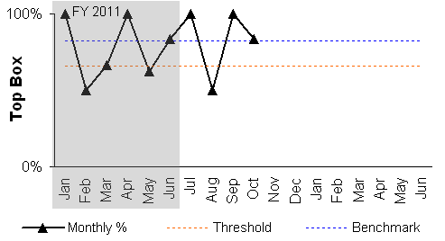
Trend Line:
Action Plan: This reflects variance in execution. Before you can design an action plan you have to do some additional homework to determine if your results reflect a “skill issue”, “will issue” or combination of both.
For skill- Are you challenged with a couple of staff or across a whole department? Your approach may be focused on the individual or a whole group. Think skills labs, seminars, elevate the subject matter in huddles, validation and follow-up.
For will- think “crucial conversations”, reinforce employee expectation and discipline if non-compliance continues.
© 2022 Huron Consulting Group Inc. and affiliates.
Notes:
Leader Variance

Slide 23
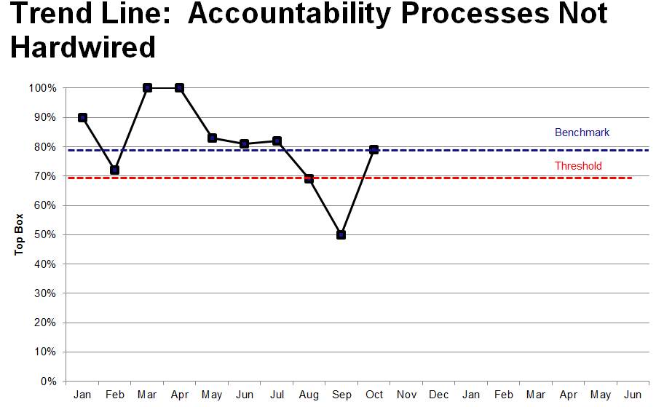
Trend Line:
Action Plan: Before any action plan can be created, complete a root cause analysis to diagnose what caused the event. Without some diagnosis, we are destined to have a repeat occurrence.
Action plans should include how to mitigate the impact related to the identified cause. If the event is in reverse (positive uptick in results), diagnose what caused the change so that you can repeat and sustain that level of performance.
© 2022 Huron Consulting Group Inc. and affiliates.
Notes:
Accountability Processes not hardwired

Slide 24
Use the Monthly Meeting to recalibrate as needed for Success
Both parties come prepared
Results drive the discussion
Plans are realistic and inclusive of all stakeholders
Clarity in expectations and next steps before meeting close
Includes review of professional development
© 2022 Huron Consulting Group Inc. and affiliates.

Slide 25
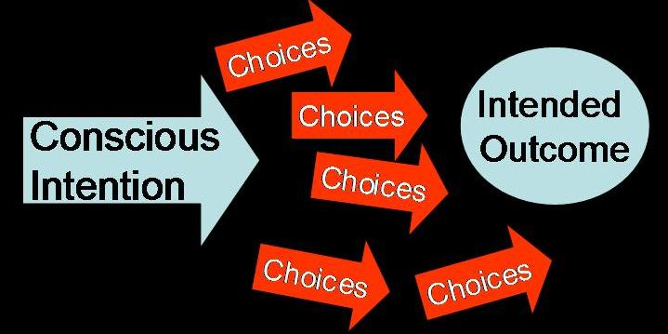
Focus on Intentional Communication
This is not about filling out forms…
It’s about moving organizational results!
Intentional Communication
Self (retrospective review of results; prospective review of internal and external variables which may impact performance)
Peers/Staff – collaborative action planning; f/up
Leadership= Verification/Validation
© 2022 Huron Consulting Group Inc. and affiliates.

Slide 26
In Leadership…Data is Your Friend!
It gives you the information necessary to drive results!
© 2022 Huron Consulting Group Inc. and affiliates.

Slide 27
Driving performance
If you are not getting the results and you have implemented the appropriate tactics….check the quality of the interaction.
Validate, Validate, Validate (observe)
Coach
Elevate Accountability
© 2022 Huron Consulting Group Inc. and affiliates.

Slide 28
Trust But Verify!
Observation is Critical to Success and Consistency in Execution
© 2022 Huron Consulting Group Inc. and affiliates.

Slide 29
Accountability takes place when leaders INSPECT what they EXPECT.”
Accountability takes place
when leaders INSPECT
what they EXPECT
Quint Studer
© 2022 Huron Consulting Group Inc. and affiliates.

Slide 30
Accountability requires you to move from here …
© 2022 Huron Consulting Group Inc. and affiliates.

Slide 31
…To here!
Verification and validation is essential. Quality must be observed.
© 2022 Huron Consulting Group Inc. and affiliates.

Slide 32
How to Effectively Validate Performance
What are the key elements?
SETTING EXPECTATIONS
OBSERVATION
PROACTIVE LISTENING AND ANALYTICAL SKILLS
GIVE EFFECTIVE FEEDBACK
RECOGNITION AND FOLLOW-UP
© 2022 Huron Consulting Group Inc. and affiliates.

Slide 33
Validating behavior change…How do YOU measure success?
1:1 Shadowing: Direct Feedback – coaching in the moment
Patient Rounds: Patient Perception – are we hearing anything different/better?
Patient Experience Survey Results: Coach to the metric – Data speaks!
Staff Meeting: Can staff articulate our focus and share what “right” looks like?
Monthly Meeting Model: How do I incorporate trends from validation and rounding into my MMM discussion?
© 2022 Huron Consulting Group Inc. and affiliates.

Slide 34
How to effectively validate performance
OBSERVATION
Be a silent observer and don’t interact with staff or patient during the interaction.
Document your observations using a skills checklist on the best practice tactic.
Screen out distractions in the hallway and try and focus on what the staff is doing.

Slide 35
How to effectively validate performance
PROACTIVE ACTIVE LISTENING AND ANALYTICAL SKILLS
Separate observations from judgments or assumptions.
Stay calm and objective at all times with staff member.
Ask open-ended questions to clarify or paraphrase when discussing and sharing information.

Slide 36
How to effectively validate performance
GIVE EFFECTIVE FEEDBACK
Have a clear vision of what “success” looks like and coach to that vision.
Be specific and timely with your feedback. Do it as soon as possible after you observe staff.
Use the sandwich approach-open comments with positive and end with positive. Constructive feedback of 1 or 2 things is the middle of the sandwich.
Be direct and concise when giving feedback-less is more approach. Staff want to return to pt. care.

Slide 37
How to effectively validate performance
RECOGNITION AND FOLLOW-UP
Recognize staff that excel or demonstrate improved skills on the spot. Use specific example of behavior.
Follow up with staff that perform poorly during the validation with additional 1-1 coaching in your office.
Be very specific about the key behaviors they need to work on before the next validation session.

Slide 38
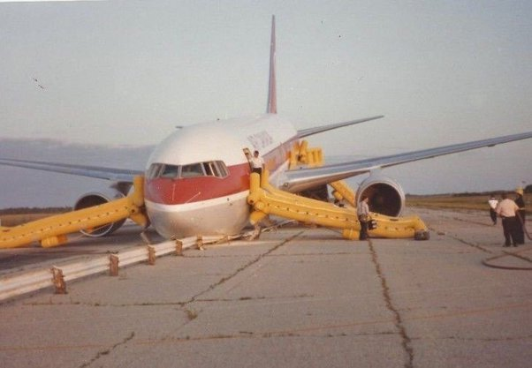
Air Canada flight 143
Notes:
Wrong data – fueling gauges were in pounds instead of kilos so to begin with there was misinformation in the type of data.
Fuel gauge had been not working, had a sign on it even though it had been repaired so the pilot thought it was not accurate

Slide 39
Final Thoughts
Implement transparent dashboards and discussions
Three Data Points are needed to establish a trend

Slide 40
What Actions Can You Take in the Next 90 Days to Improve?

Slide 41
What Questions Do You Have? Key Take-Aways

Slide 42
Thank you!!
© 2022 Huron Consulting Group Inc. and affiliates.

